Slide 1



"Exploratory data analysis of a clinical study group - revealing patient subgroups"
Bogumil M. Konopka
Department of Biomedical Engineering
Faculty of Fundamental Problems of Technology
Wroclaw University of Science and Technology, POLAND

Slide 2

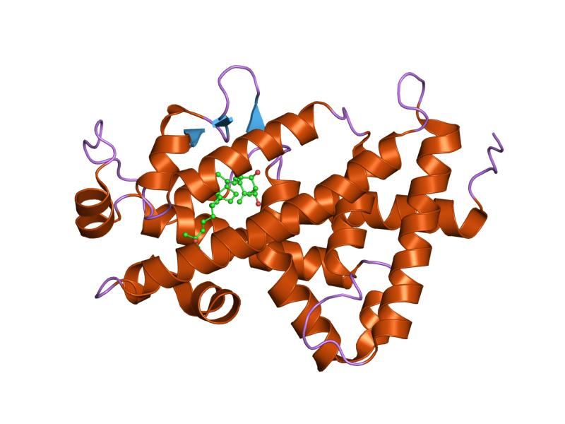
Assessing the influence of Vitamin D Receptor gene polymorphisms („changes” in DNA) (Lukasz Laczmanski Ph.D., D. Sc. , Wroclaw Medical University)
Vitamin D Receptor
Bone formation
regulates
Innate immune response
Cell proliferation and differentiation
PDB_ID: 2hb8
Our research hypothesis:
VDR polymorphisms influence sex hormone blood levels
The plan:
Explore gathered clinical data
Build regression models relating VDR polymorphisms and blood levels of sex hormones
Notes:
Receptor Vitaminy D pełni istostną rolę w homeostazie skłdników mineralnych kości.
Revealing the structure of the data means answering the following questions:
Are there any significant outliers in the dataset?
What subgroups make up for the dataset?
What are the characteristics of particular subgroups?
And finally, what are the biological reasons that underlie such dataset structure?

Slide 3
Dataset & questions
44 attributes
Main questions:
Are there any outliers in the dataset?
What subgroups make up for the dataset?
What are the characteristics of particular subgroups?
What are the biological reasons that underlie such dataset structure?
23 numerical
21 nominal
AGE, BMI, GLUCOSE, …
COUNTRY. REGION, YEAR.SEASON OBESITY,…
515 samples
277 male ♂
238 female ♀
Notes:
The data had to be cleared of varius flaws – like typos or wrong values, duplicate entries, etc…

Slide 4
Dataset & questions
44 attributes
Main questions:
Are there any outliers in the dataset?
What subgroups make up for the dataset?
What are the characteristics of particular subgroups?
What are the biological reasons that underlie such dataset structure?
23 numerical
21 nominal
AGE, BMI, GLUCOSE, …
COUNTRY. REGION, YEAR.SEASON OBESITY,…
515 samples
277 male ♂
238 female ♀
Notes:
The data had to be cleared of varius flaws – like typos or wrong values, duplicate entries, etc…

Slide 5
Overview of data processing procedure
Normalization
(robust Z-Score)
Outlier detection
(Mahalanobis Distance MD)
Hierarchical clustering
(Ward’s algorithm)
Visualization
(PCA biplot)
All based on data variance.
(Murtagh, Legendre, 2014)

Slide 6
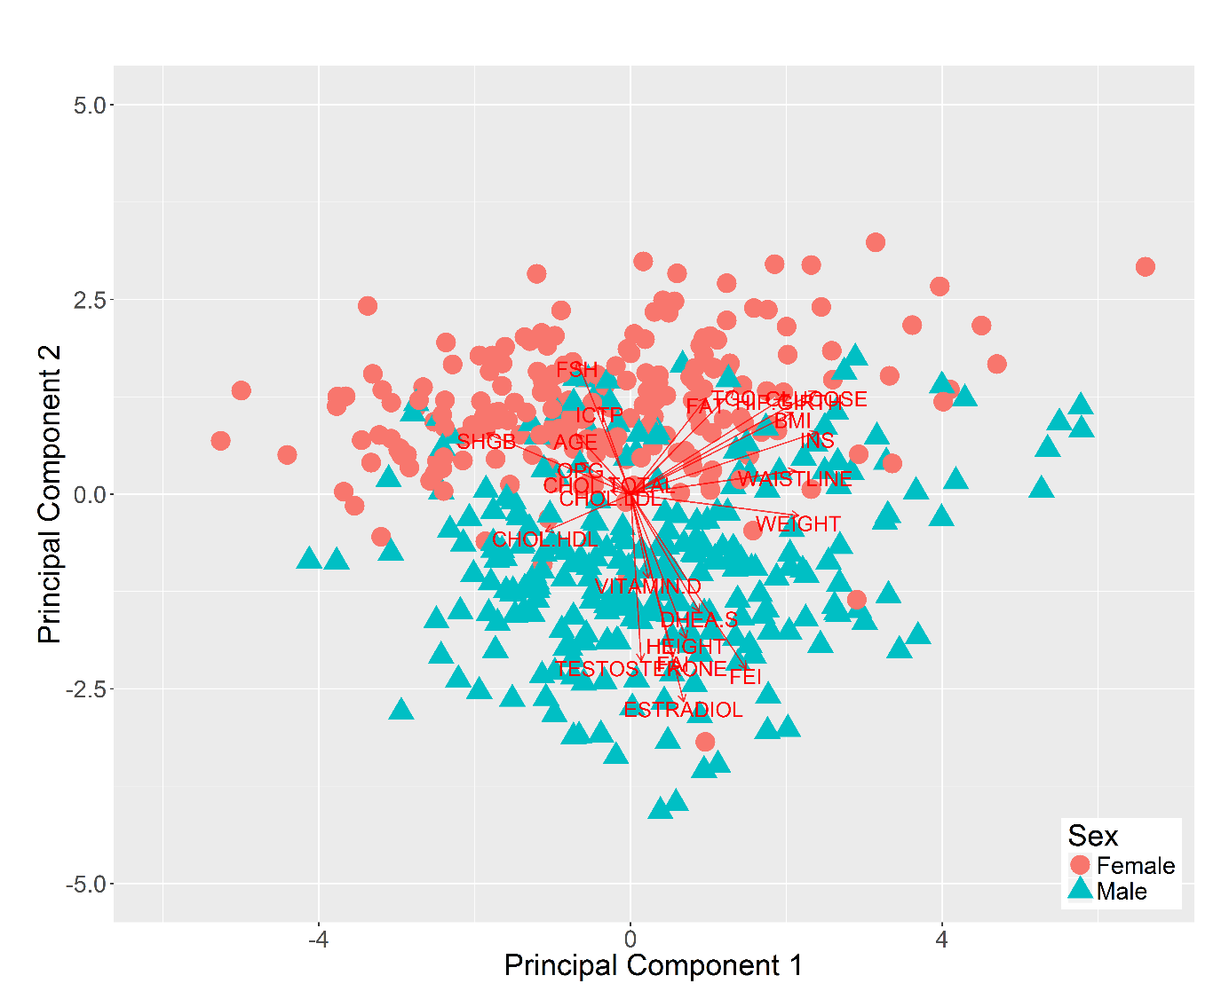
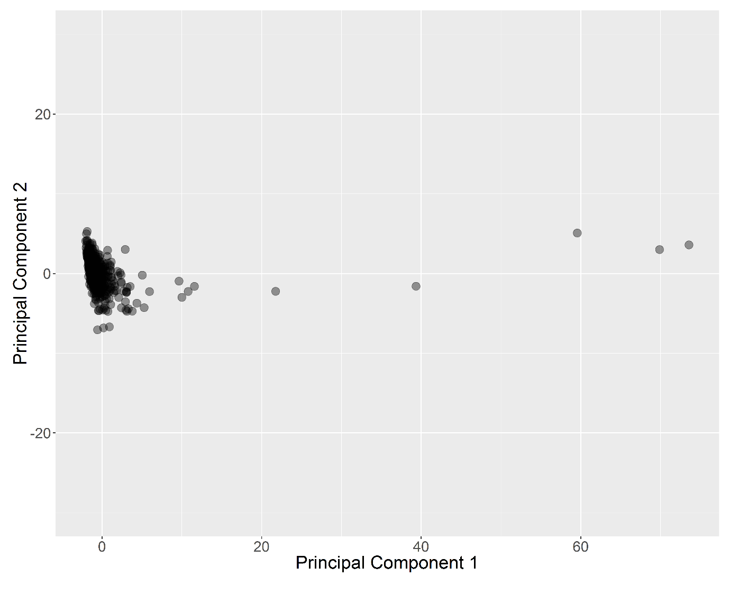
Introductory analysis
Outliers in the data set
Outliers removed
Need to separate MALE and FEMALE patients

Slide 7
Male set analysis - outlier removal
Outliers based on Mahalanobis Distance (MD):
22 patients
Outlier detection with robust Mahalanobis Distance (rMD):
124 patients
The data set is heterogeneous and may contain subgroups

Slide 8
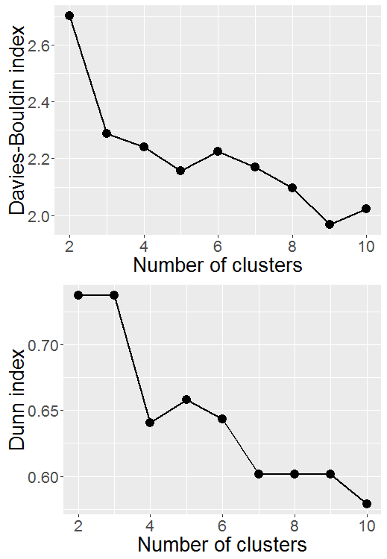
Male set analysis – hierarchical clustering
Low values - good
Low values - bad

Slide 9
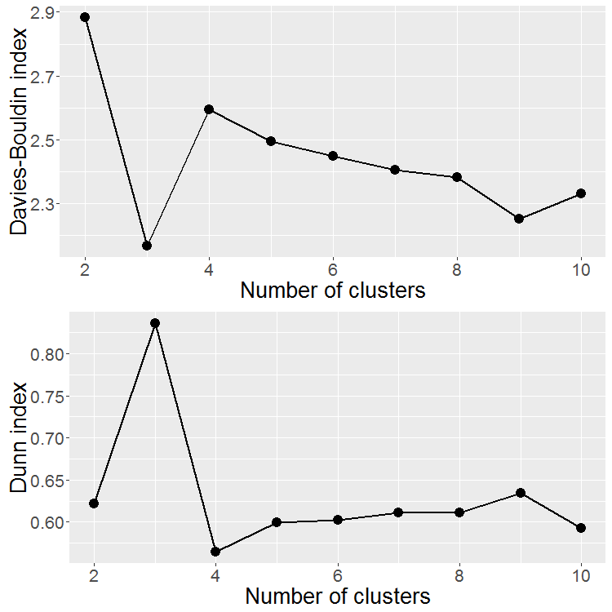
Addition of categorical data
Low values - good
Low values - bad

Slide 10
Male set analysis – summarizing data

Slide 11
Methodological conclusions
MD vs rMD plot
Emphasis of the data set heterogeneity
Ward’s hierarchical clustering + PCA
Consistent grouping & visualization of patient groups
PCA with biplot vectors
Facilitated biological interpretation of structure of the data
Tutorial paper to be submitted to Statistics in Medicine (Wiley)

Slide 12
Biological conclusions
There are 5 distinct patient subgroups
Among them patients with elevated FSH and low TESTOSTERONE (hypogonadism)
There are three groups of attributes:
Age-related attributes
Obesity-related attributes
Sex-hormones related and other

Slide 13

Department and Clinic of Endocrinology, Diabetology and Isotope Therapy, Wroclaw Medical University
Łukasz Łaczmański
Department of Health Promotion, University School of Physical Education, Wroclaw
Felicja Lwow
bogumil.konopka@pwr.edu.pl

Slide 14
Additional slides

Slide 15
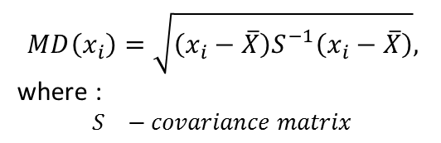
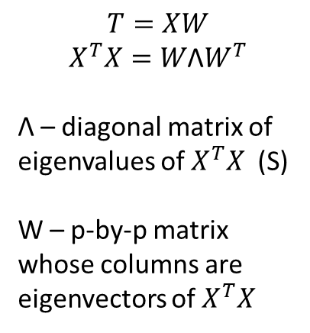
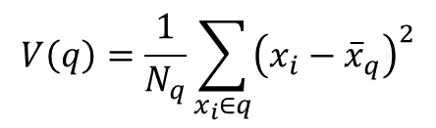
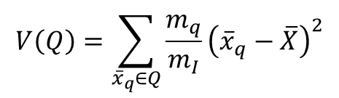
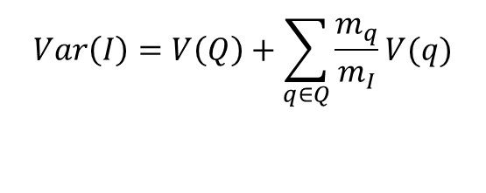
Why use the Ward’s algorithm
Outlier detection
(Mahalanobis Distance MD)
Hierarchical clustering
(Ward’s algorithm)
Visualization
(PCA)
$$MD\left(x_{i}\right)=\sqrt{\left(x_{i}−\overline{X}\right)S_{}^{−1}\left(x_{i}−\overline{X}\right)},$$
where :
$$S_{}−covariance matrix$$
$$Var\left(I\right)=V\left(Q\right)+\sum_{q∈Q}{\frac{m_{q}}{m_{I}}}V(q)$$
$$T=XW$$
$$X^{T}X=W\text{Λ}W^{T}$$
Λ – diagonal matrix of eigenvalues of $X^{T}X$ (S)
W – p-by-p matrix whose columns are eigenvectors of $X^{T}X$
Maximize inter-cluster variance
Minimize within cluster variance
$$V\left(Q\right)=\sum_{{\overline{x}}_{q}∈Q}{\frac{m_{q}}{m_{I}}{\left({\overline{x}}_{q}−\overline{X}\right)}^{2}}$$
$$V\left(q\right)=\frac{1}{N_{q}}\sum_{x_{i}∈q}{{\left(x_{i}−{\overline{x}}_{q}\right)}^{2}}$$
Q – partitioning
q - cluster
Notes:
Ward’s algorithm decomposes the total variance of a cloud of points into inter-cluster variance and within-cluster variance. It than uses a criterion that minimizes the variance of a cluster that results from a fusion of two agglomerants. In general the algorithm minimizes the within-group variance and maximizes the inter-cluster variance.
PCA is a different way of presenting variance among observations. It decomposes the variance into orthogonal dimensions and tries to maximize the variance kept in the subsequent dimensions of a resulting transformation.
Clustering and PCA use involve different yet complementary spatial and clustering models that are fit to the data using the same mathematical principle. That is why clusters aquired by Ward’s algorithm

Slide 16
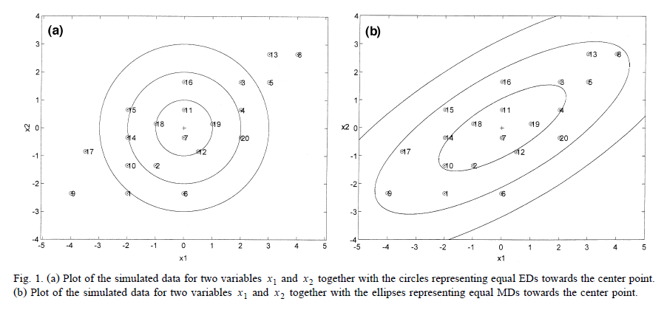
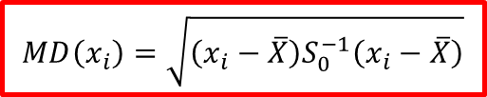
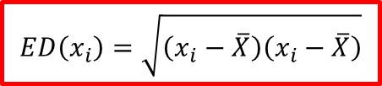
Outlier detection with Mahalanobis Distance - intuition
De Maesschalck R, et al., Chemometrics and Intelligent Laboratory Systems 50 2000. 1–18
Euclidean distance
Mahalanobis distance (MD)
$$ED\left(x_{i}\right)=\sqrt{\left(x_{i}−\overline{X}\right)\left(x_{i}−\overline{X}\right)}$$
$$MD\left(x_{i}\right)=\sqrt{\left(x_{i}−\overline{X}\right)S_{0}^{−1}\left(x_{i}−\overline{X}\right)}$$
chemometrics: Multivariate Statistical Analysis in Chemometrics
http://cran.r-project.org/web/packages/chemometrics/index.html

Slide 17
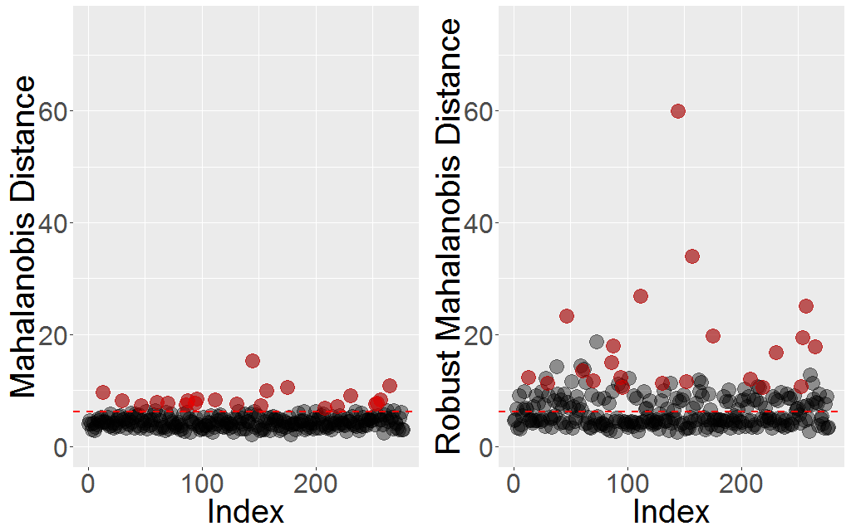
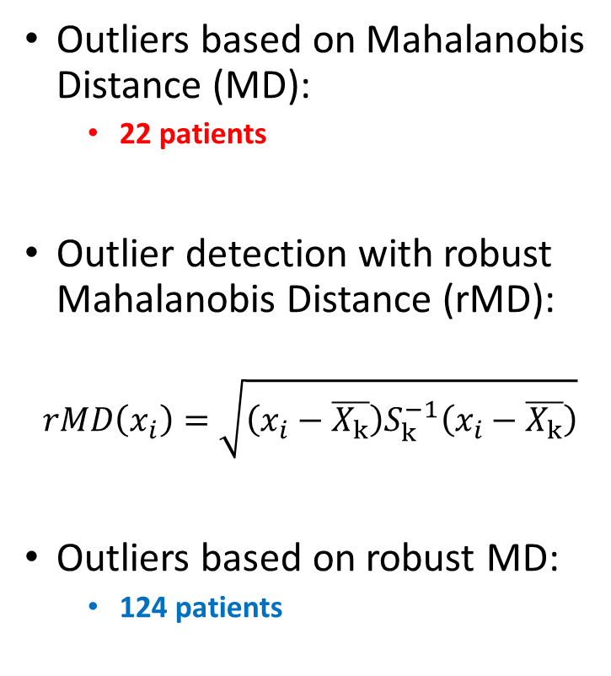
Male set analysis - outlier removal
Outliers based on Mahalanobis Distance (MD):
22 patients
Outlier detection with robust Mahalanobis Distance (rMD):
$$rMD\left(x_{i}\right)=\sqrt{\left(x_{i}−\overline{X_{k}}\right)S_{k}^{−1}\left(x_{i}−\overline{X_{k}}\right)}$$
Outliers based on robust MD:
124 patients
Notes:
A 97.5% quantile cut-off for a Chi-squared distribution is used to remove outlier values

Slide 18
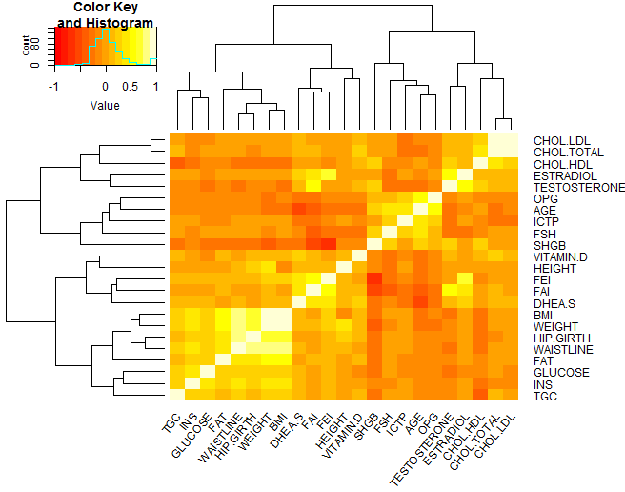
Clustering of attributes based on correlation

Slide 19
Female set analysis – outlier removal
MD and rMD suggest removal of 20 and 70 data points
Data points are more condensed

Slide 20
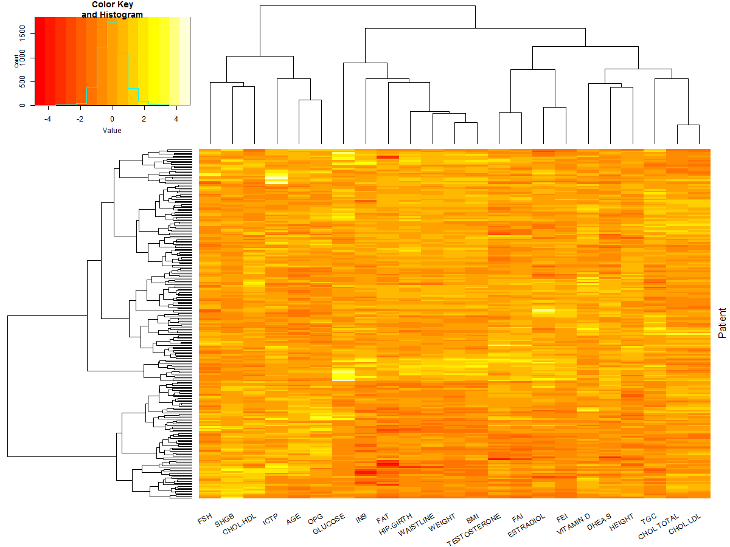
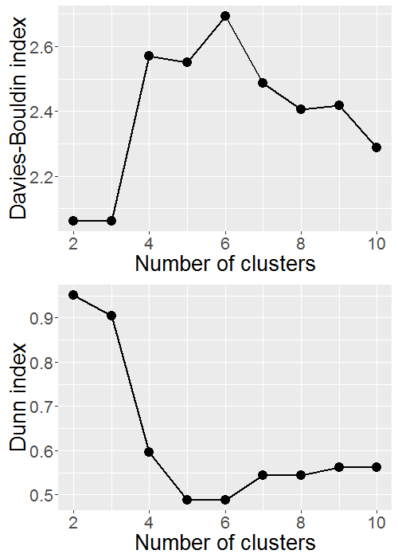
Female set analysis – hierarchical clustering

Slide 21
Female set analysis – hierarchical clustering
Three subgroups have been identified
Cluster 3 – diabetes
The set is more homogeneous
Three groups of attributes have been identified:
Age-related attributes
Obesity-related attributes
Sex-hormones related and other

